Slide 1
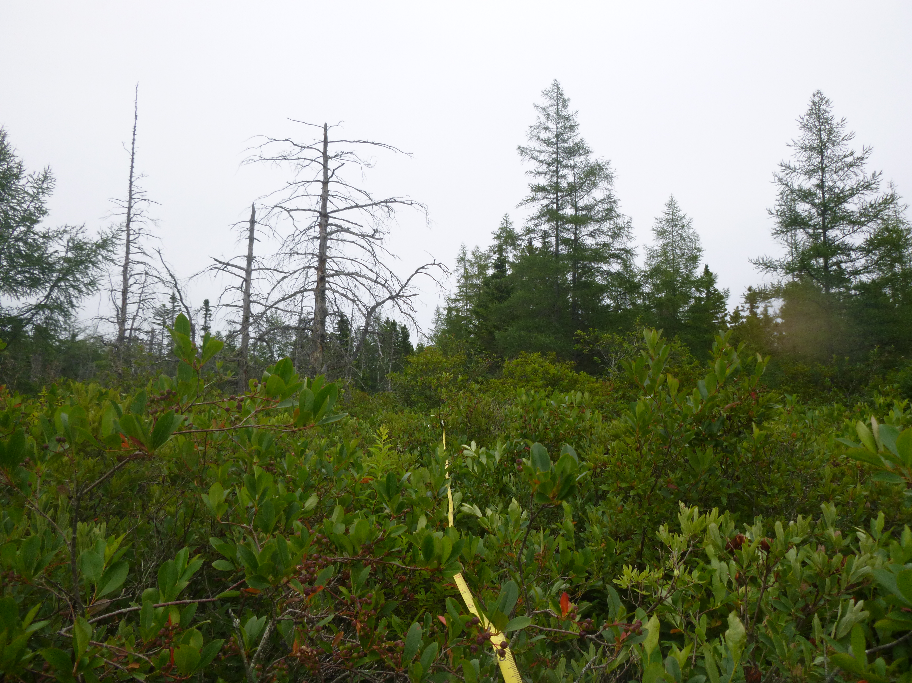
RAM-01 East (090)

